Slide 1

Use Related Risk in Medical Devices
Sami Durrani PhD and Eric Bergman PhD
Notes:
Quick introductions

Slide 2
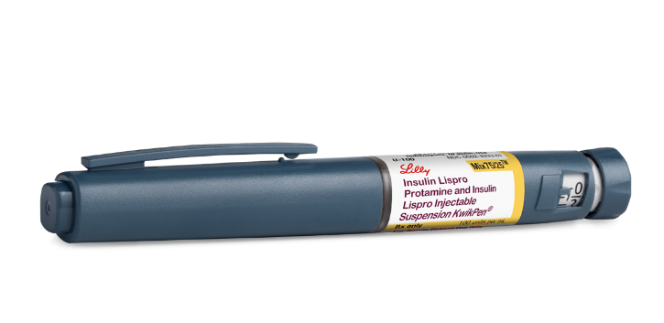
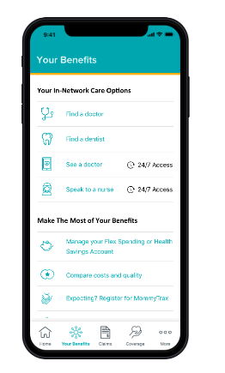
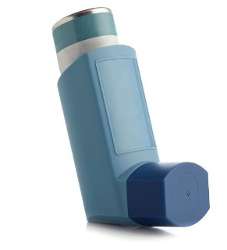
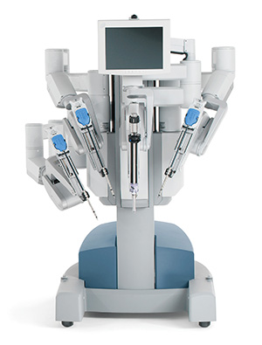
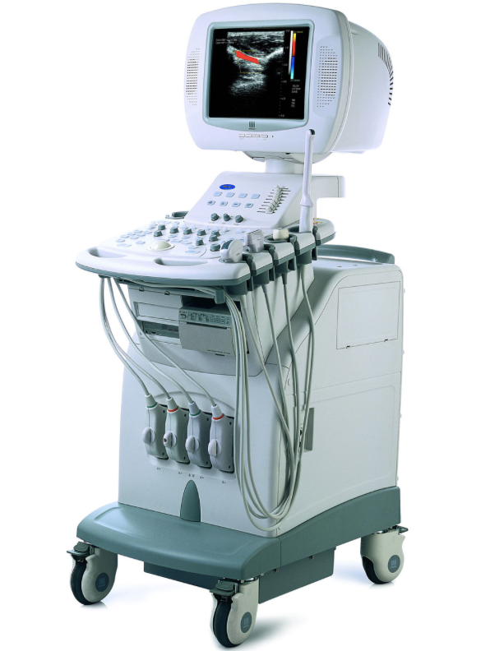
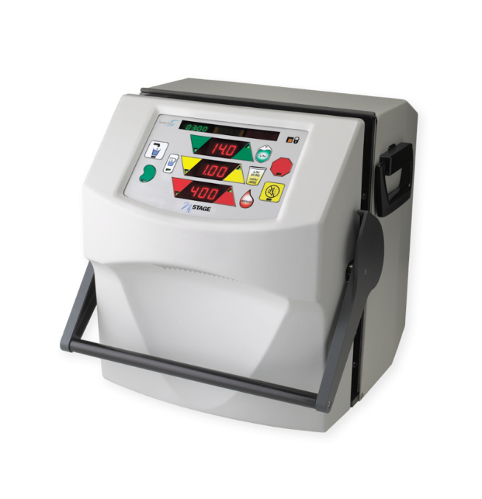
Examples of medical devices
Notes:
Sami
Medical devices encompass a wide range of equipment, instruments, implants, or software used in healthcare for diagnosis, treatment, monitoring, or prevention of diseases. They play a crucial role in modern medicine.
They help improve patient outcomes, enhance the efficiency of healthcare delivery, and contribute to the overall quality of care. They are used across various medical specialties, from diagnostics to life support.
Here are some examples of medical devices, and you can see that they can range from something as “simple” (in air quotes) as drug deliver devices like an insulin pen or an inhaler to complex machines like a home dialysis machine to a robotic surgical system.

Slide 3
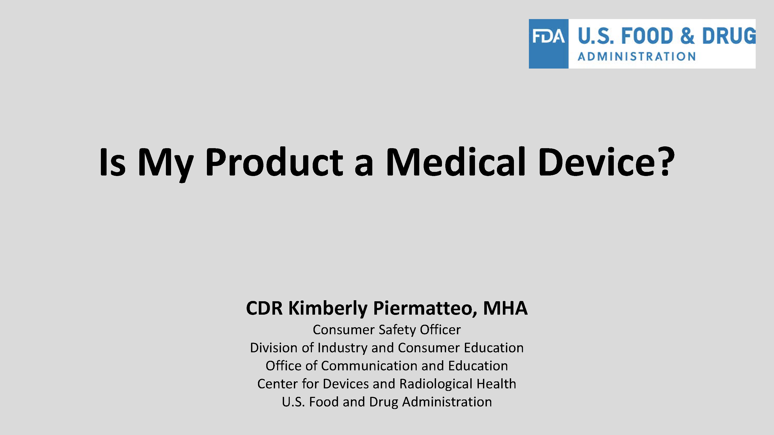
Medical device definition
Assigned reading:
https://www.fda.gov/media/131268/download
Notes:
Sami: FDA has a great presentation available on their website
A medical device, according to the FDA, is a tool or apparatus intended for diagnosing, treating, or preventing disease, not primarily functioning through chemical action in the body.
Defining medical devices can be tricky, FDA has a great presentation on this that we can review together quickly.

Slide 4



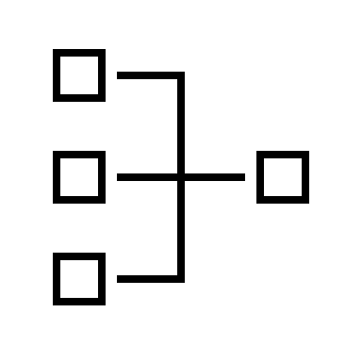
Medical device “user interface” includes…
The IFU (instructions for use)
Packaging & Labeling
Training
In the end, all the elements of the system with which the user interacts to learn and operate the device
Notes:
Eric
Can also use this slide as a bridge to the next one about guidance and standards

Slide 5
Use-related risk in medical device design
Goal of medical device development is to make products:
Safe
Effective
Efficient
Satisfying user experience
Regulatory Requirement
Business goal
User interface designs that do not mitigate use errors detract from all the above goals!
Yes – designs!
KEY CONCEPT: Use errors are a consequence of the device’s design
Notes:
In descending order.
Key concept: we do not blame the user for making errors. Use errors are a function of the device design

Slide 6

Use Error, not User Error
KEY CONCEPT: Potential for use errors can be mitigated by good design
(by applying a robust Human Factors Engineering process)
Notes:
"Humans are flawed in that we have limitations, imperfections, or tendencies in human behavior, cognition, and decision-making that can lead to errors, mistakes, or suboptimal outcomes. These flaws are a natural part of being human.

Slide 7
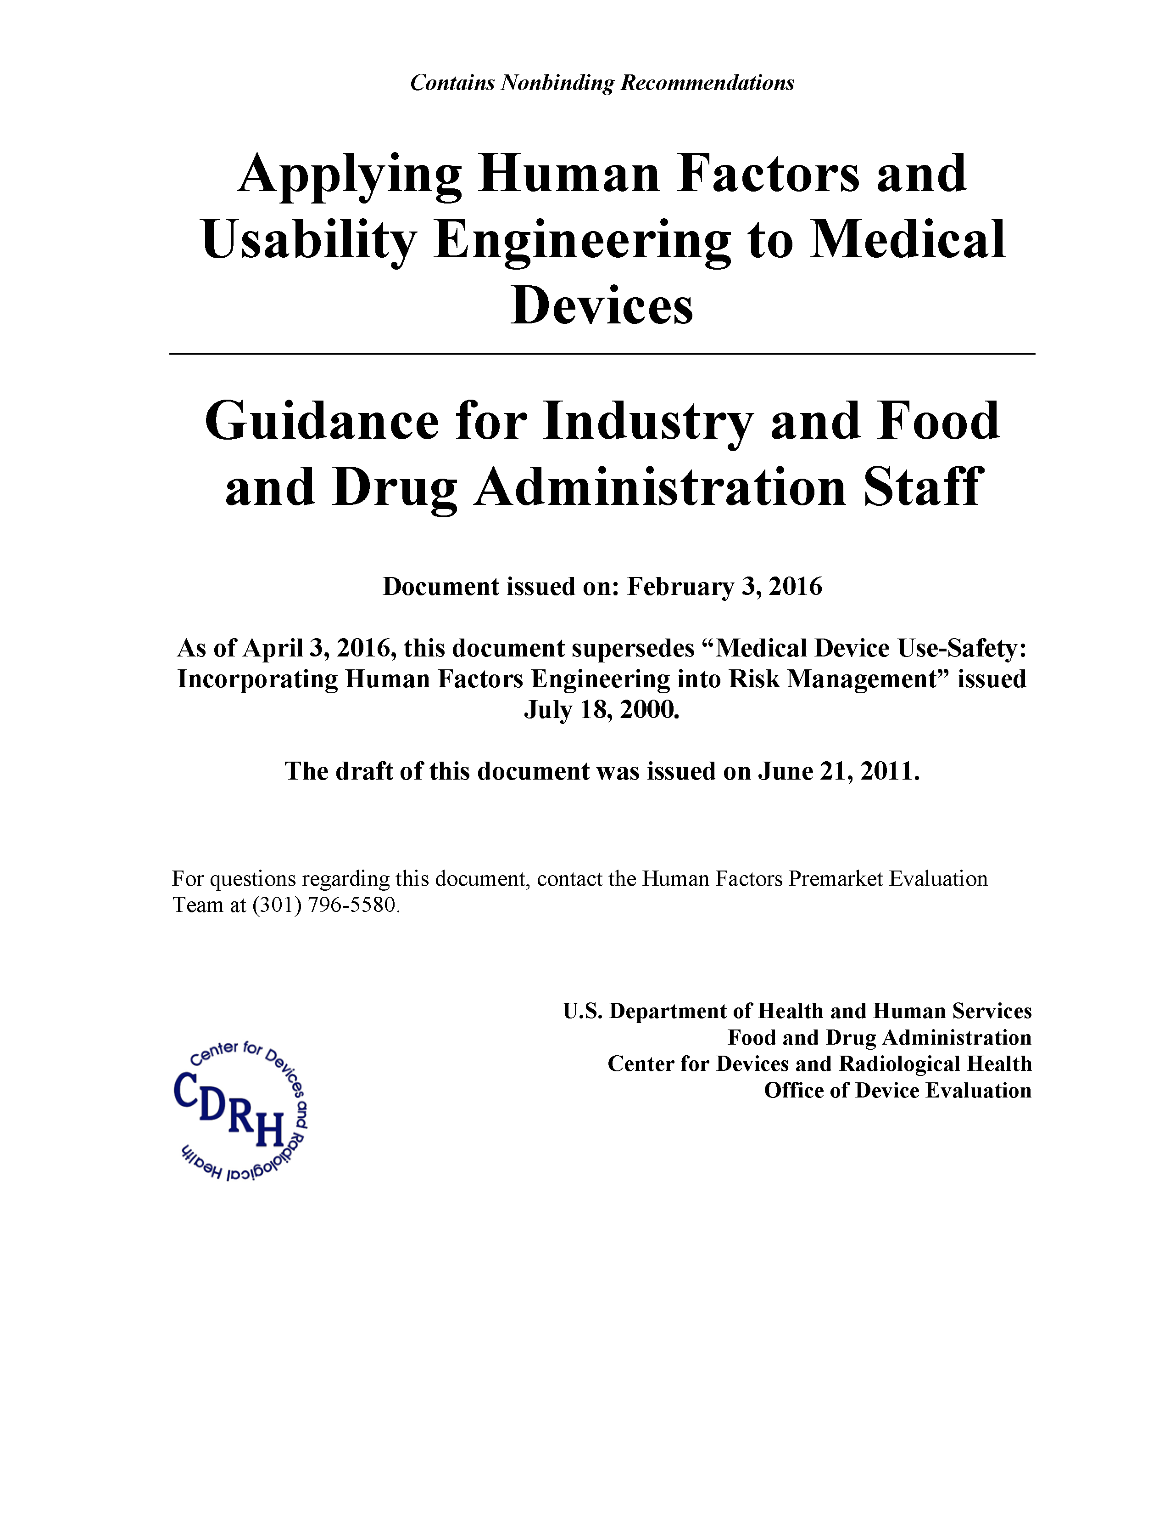

Key Guidance & Standards
Notes:
Sami: What are the bodies and standards that govern how we assess use related risk in medical device design.
Covered extensively in other classes – insert class name.
So why is this important? Essentially, medical device development is a risk based approach. What the FDA and most other regulators want to see is that your device is “safe and effective”. What does that mean? It means that people can use it to deliver the therapeutic value, and they can use it safely.

Slide 8
Key activities – HF med device process
Use specification
Use-related risk analysis (URRA)
User interface design (including risk control measures)
Formative and validation testing
Report / submission documents

Slide 9
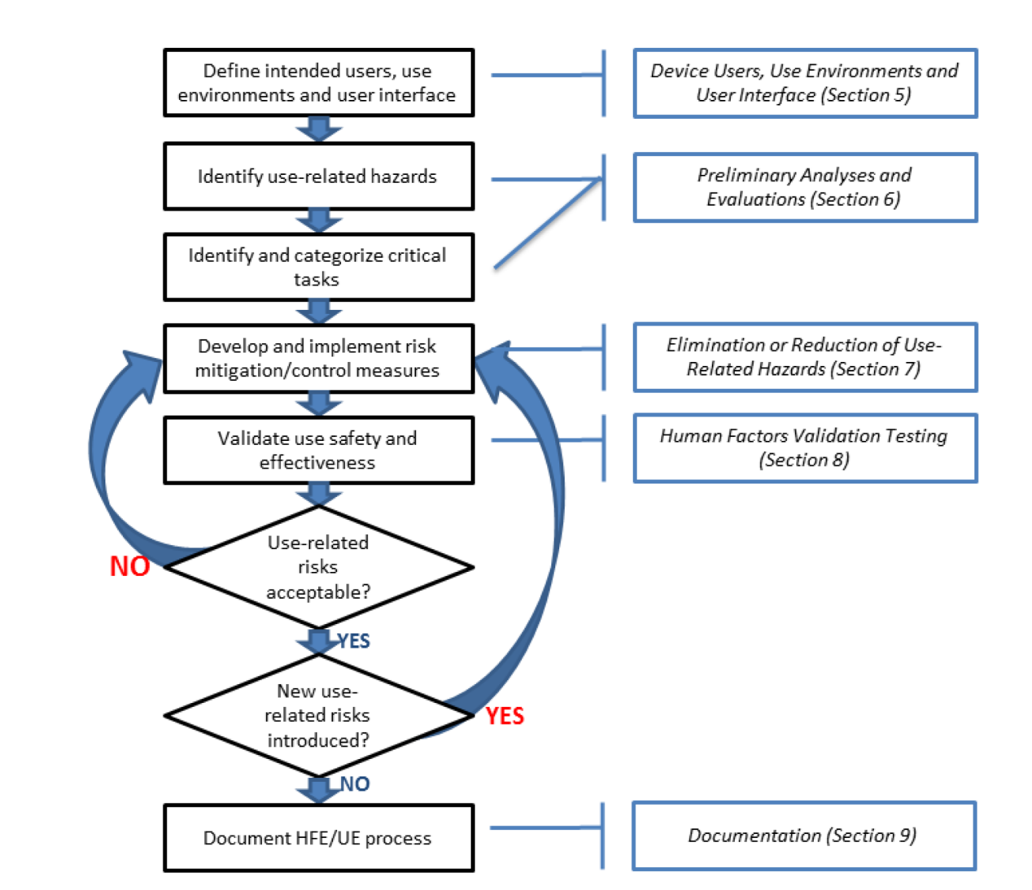
Use-related risk analysis process (as defined by FDA)
Formative testing
Residual risk analysis
Image source: Applying Human Factors and Usability Engineering to Medical Devices. FDA Feb 2016
Notes:
Again, as mentioned in the previous slide there are different ways to implement steps in this process – they may have slightly different names or formats, but fundamentally will have to address to process steps defined in the diagram above.
(e.g., uFMEA, Task Analysis, FTA, etc0

Slide 10
Wait? Is URRA a process or document?
Its both
The process to identify your use related risks
A nd the document that you use to compile your use-related risks
Important note: Nomenclature and exact process varies by companies
Notes:
This is perhaps one of the most confusing aspects of human factors in risk analysis.
Important to note that URRA is a “term of art” – there are many approaches and formats to creating a URRA.
In fact, many companies don’t even have a document with the name “URRA”, but they have a document (and associated process) that serves this purpose (use related risk analysis).

Slide 11
URRA document decomposed
A URRA needs to contain the following:
Reference number
Task description
Potential use errors
Potential hazards and harms
Severity of harm
Critical task (yes or no)
Risk mitigations
Reference to validation of risk mitigation effectiveness
Notes:
Highlight briefly and mention that we will speak to URRA in more detail in slides ahead
Task vs use step or sub-task vs scenario
Probabilities are not included
What is a critical task?
What are risk mitigations (also referred to as risk controls by some)
Let’s discuss this in detail:

Slide 12
URRA in a tabular format
Ref # | Use Task Description | Potential Use Error | Potential Hazard/Clinical Harm | Severity of Harm | Critical Task (Y/N) | Risk Control (Mitigation) | Evaluation Method
1 | Read blood glucose from display | Incorrectly identifies BG value | Incorrect insulin dose leading to coma or death | 5 | Y | Increase font size | usability study
Is font change an adequate control?

Slide 13
URRA document decomposed
A URRA needs to contain the following:
Reference number
Task description
Potential use errors
Potential hazards and harms
Severity of harm
Critical task (yes or no)
Risk mitigations
Reference to validation of risk mitigation effectiveness
Notes:
Highlight briefly and mention that we will speak to in more detail
Task vs use step or sub-task vs scenario
Probabilities are not included
What is a critical task?
What are risk mitigations (also referred to as risk controls by some)
Lets discuss this in detail:

Slide 14
Reference number
Using straight sequential numbers can cause challenges in risk management documents if additional tasks, use steps, or features are added to a device
Companies often use various coding schema to mitigate
For example: Task AB 1.0.0
Note: FDA refers to this as Task Number in their guidance, I recommend calling it URRA # (or some other signifier) to avoid confusion with HF validation task numbers.

Slide 15
Imagine adding another task after task #1
Ref # | Use Task Description | Potential Use Error | Potential Hazard/Clinical Harm | Severity of Harm | Critical Task (Y/N) | Risk Control (Mitigation) | Evaluation Method
1 | Task | Error description | Infection | 4 | Y | Control description | usability study
2 | Task that follows | Error description | Death | 5 | Y | Control description | usability study
3 | Task that follows | Error description | Delay of treatment | 2 | N | Control description | usability study
Ref # | Use Task Description | Potential Use Error | Potential Hazard/Clinical Harm | Severity of Harm | Critical Task (Y/N) | Risk Control (Mitigation) | Evaluation Method
1.0 | Task | Error description | Infection | 4 | Y | Control description | usability study
1.1 | Task inserted | Error description | Paralysis | 5 | Y | Control description | Usability study
2.0 | Task that follows | Error description | Death | 5 | Y | Control description | usability study
3.0 | Task that follows | Error description | Delay of treatment | 2 | N | Control description | usability study
Notes:
It is common to identify additional tasks during the human factors engineering process, or to realize that a task could be decomposed into several tasks. For this reason, the reference numbers must evolve/scale over time.
Let’s consider one way to reference tasks instead of an integer sequence…

Slide 16
URRA document decomposed
A URRA needs to contain the following:
Reference number
Task description
Potential use errors
Potential hazards and harms
Severity of harm
Critical task (yes or no)
Risk mitigations
Reference to validation of risk mitigation effectiveness
Notes:
Highlight briefly and mention that we will speak to in more detail
Task vs use step or sub-task vs scenario
Probabilities are not included
What is a critical task?
What are risk mitigations (also referred to as risk controls by some)
Lets discuss this in detail:

Slide 17
Task description
A short description of the specific action or goal that is required to be achieved by the user
Forms the basis for evaluating potential use errors
Terms you might also use:
Sub-task: Break down the broader task into its component actions. They are the smaller individual actions that collectively make up a task.
Use-step: Detailed, step-by-step actions or interactions that the user takes with the device. They are finer-grained than subtasks and provide explicit instructions or sequences.

Slide 18
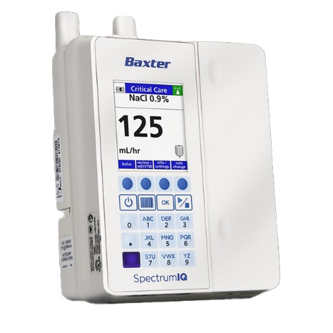
Task - Example # 1
Device: Infusion pump
Task: Deliver medication to patient
Sub-tasks:
Select the correct drug from the pump’s on-screen menu
Set the appropriate dosage
Set infusion rate
Start infusion
Use steps for sub-task 2 above:
Press the Menu button on home screen
Press Dosage Settings
Enter the prescribed dose amount using keypad
Press Enter

Slide 19
Task - Example # 2
Device: Pen-injector
Task: Inject medication to self
Sub-tasks:
Inspect drug for expiration
Dial dose to correct amount
Inject into correct location on skin
Press knob till fully depressed
Hold for 5 seconds
Use steps for sub-task 1 above:
Is there any more granularity needed than the above?
Wait, should this be a task?
There often isn’t one “right” way of defining tasks vs subtasks vs use-steps, often requires judgement.
What’s important is that your analysis is comprehensive and consistent

Slide 20
URRA document decomposed
A URRA needs to contain the following:
Reference number
Task description
Potential use errors
Potential hazards and harms
Severity of harm
Critical task (yes or no)
Risk mitigations
Reference to validation of risk mitigation effectiveness
Notes:
Highlight briefly and mention that we will speak to in more detail
Task vs use step or sub-task vs scenario
Probabilities are not included
What is a critical task?
What are risk mitigations (also referred to as risk controls by some)
Lets discuss this in detail:

Slide 21
Potential use errors
FDA definition: User action or lack of action that was different from that expected by the manufacturer and caused a result that:
(1) was different from the result expected by the user and
(2) was not caused solely by device failure and
(3) did or could result in harm

Slide 22
Identifying potential use errors?
Potential use errors
Post market surveillance
Known use- problems analysis
Task analysis
HF testing data
Expert and heuristic analyses
FMEAs
Other sources

Slide 23
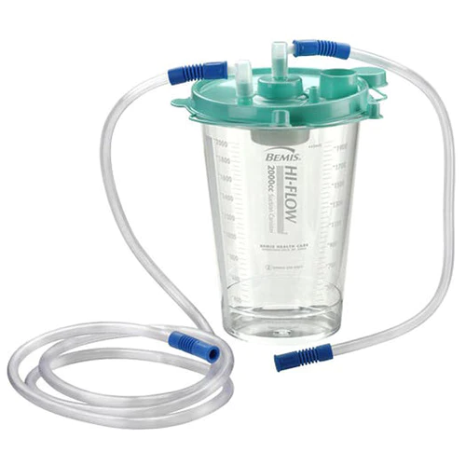
Example
Product: Surgical Suction Device
Task: Connect hose to canister
Task Analysis:
Sub-task 1: Select correct hose
Potential use errors:
User selects wrong hose
Sub-task 2: Slide blue tip of hose onto canister’s inflow connector completely
Potential use errors:
Does not attach hose at all
User does not fully slide hose onto connector (poor connection)
User attaches hose to canister’s outflow connector
Notes:
When you write this up in an actual excel, you might call this sub task, instead of calling them step

Slide 24
Example
Product: Surgical Suction Device
Task: Connect hose to canister
BUT from post market surveillance data:
A case where a tech rubbed lubricant onto the connecter to make it easier to connect hose → led to hose being pulled off during surgery
Use error: User lubricates connectors
Notes:
When you write this up in an actual excel, you might call this sub task, instead of calling them step

Slide 25
URRA document decomposed
A URRA needs to contain the following:
Reference number
Task description
Potential use errors
Potential hazards and harms
Severity of harm
Critical task (yes or no)
Risk mitigations
Reference to validation of risk mitigation effectiveness
Notes:
Highlight briefly and mention that we will speak to in more detail
Task vs use step or sub-task vs scenario
Probabilities are not included
What is a critical task?
What are risk mitigations (also referred to as risk controls by some)
Lets discuss this in detail:

Slide 26
Potential hazards and harms
Task: Removing cap from pre-filled syringe
Hazard: Needle
Hazardous situation: Uncapped needle
Harm: Needlestick
Task: Cleaning reusable surgical equipment
Hazard: Pathogens
Hazardous situation: Incomplete surgical equipment disinfection
Harm: Infection
Task: Configuring ventilator
Hazard: Oxygen
Hazardous situation: Ventilator provides too much oxygen
Harm: Hyperoxia (oxygen toxicity)

Slide 27
URRA document decomposed
A URRA needs to contain the following:
Reference number
Task description
Potential use errors
Potential hazards and harms
Severity of harm
Critical task (yes or no)
Risk mitigations
Reference to validation of risk mitigation effectiveness
Notes:
Highlight briefly and mention that we will speak to in more detail
Task vs use step or sub-task vs scenario
Probabilities are not included
What is a critical task?
What are risk mitigations (also referred to as risk controls by some)
Lets discuss this in detail:

Slide 28
Severity of harm
Potential degree of injury or negative health impact
Typically graded on a numerical scale on a 1-5 scale
Common example:
Severity 1 - Negligible: No injury or only a slight inconvenience.
Severity 2 - Minor: Temporary injury or impairment, not requiring professional medical intervention.
Severity 3 - Moderate: Temporary injury or impairment requiring professional medical intervention.
Severity 4 - Severe: Permanent impairment or injury that has a substantial impact on the patient's life.
Severity 5 - Catastrophic: Death or an injury leading to a long-term or permanent severe decrease in the patient's quality of life.
Notes:
Requires medical profession to assess.
Speak to cross-functional nature of URRA.

Slide 29
URRA document decomposed
A URRA needs to contain the following:
Reference number
Task description
Potential use errors
Potential hazards and harms
Severity of harm
Critical task (yes or no)
Risk mitigations
Reference to validation of risk mitigation effectiveness
Notes:
Highlight briefly and mention that we will speak to in more detail
Task vs use step or sub-task vs scenario
Probabilities are not included
What is a critical task?
What are risk mitigations (also referred to as risk controls by some)
Lets discuss this in detail:

Slide 30
Critical task (yes or no)
A user task that, if performed incorrectly or not performed at all, could lead to [serious / any] harm
Examples:
Infusion pump, a critical task might be setting the correct drug dosage.
Defibrillator, a critical task might be correctly placing the electrode pads.
Typically, the focus of design, formative, and validation testing
Regulators require documentation that demonstrates how critical tasks were identified, evaluated, and tested to ensure the safe use of the device.
Notes:
Critical tasks are especially significant because they directly impact the safety and effectiveness of a medical device.
Identifying and thoroughly evaluating critical tasks during the device design and testing process ensures that potential use-related hazards are addressed.

Slide 31
URRA document decomposed
A URRA needs to contain the following:
Reference number
Task description
Potential use errors
Potential hazards and harms
Severity of harm
Critical task (yes or no)
Risk mitigations
Reference to validation of risk mitigation effectiveness
Notes:
Highlight briefly and mention that we will speak to in more detail
Task vs use step or sub-task vs scenario
Probabilities are not included
What is a critical task?
What are risk mitigations (also referred to as risk controls by some)
Lets discuss this in detail:

Slide 32
Risk mitigation (or controls)
Preferred Risk Control Strategy: Inherent Safety by Design
Design device such that a hazard is eliminated
Example: Design a device for single use and distribute it sterilized in the package so that infection related to contamination cannot occur.
Less Preferred Risk Control Strategy: Protective Measures
Reduce risk by incorporating protective measures that reduce the probability of occurrence of a hazardous situation.
Example: Sound an alarm when a device is about to deliver radiation therapy
Least Preferred Risk Control Strategy: Information for Safety
Provide information for safety in instructions for use and warnings.
Example: A diagnostic device label states “do not use in a moving vehicle”
Example: The manual states “always unplug before cleaning”

Slide 33
Risk mitigation (or controls)
Task: Removing cap from pre-filled syringe
Hazard: Needle
Harm: Infection
Potential controls:
Improved package formatting/labeling (good)
Needle guard (better)
Needle only presents at injection (best)

Slide 34
URRA document decomposed
A URRA needs to contain the following:
Reference number
Task description
Potential use errors
Potential hazards and harms
Severity of harm
Critical task (yes or no)
Risk mitigations
Reference to validation of risk mitigation effectiveness
Notes:
Highlight briefly and mention that we will speak to in more detail
Task vs use step or sub-task vs scenario
Probabilities are not included
What is a critical task?
What are risk mitigations (also referred to as risk controls by some)
Lets discuss this in detail:

Slide 35
Reference to validation of risk mitigation effectiveness
Simply a pointer to where the risk controls were validated as effective
Typically, a task # in a simulated-use validation study, a knowledge question #, or other acceptable source

Slide 36
URRA document decomposed
A URRA needs to contain the following:
Reference number
Task description
Potential use errors
Potential hazards and harms
Severity of harm
Critical task (yes or no)
Risk mitigations
Reference to validation of risk mitigation effectiveness
Notes:
Highlight briefly and mention that we will speak to in more detail
Task vs use step or sub-task vs scenario
Probabilities are not included
What is a critical task?
What are risk mitigations (also referred to as risk controls by some)
Lets discuss this in detail:

Slide 37
Wait! - What about the frequency, Kenneth?
(i.e., probability)
According to 14971: Risk = probability of occurrence x severity of harm
FDA's stance: "probability is very difficult to determine for use errors, and in fact many use errors cannot be anticipated until device use is simulated and observed, the severity of the potential harm is more meaningful for determining the need to eliminate (design out) or reduce resulting harm"

Slide 38
Use related risk analysis is not…
Simply a collection of tools (e.g., task analysis)
A formula that will make decisions for you
A one-time activity
Something to do at the end of the design process / for submission documentation only

